Slide 1

Parallel Computing in Bioconductor
Jiefei Wang
08/02/2023

Slide 2
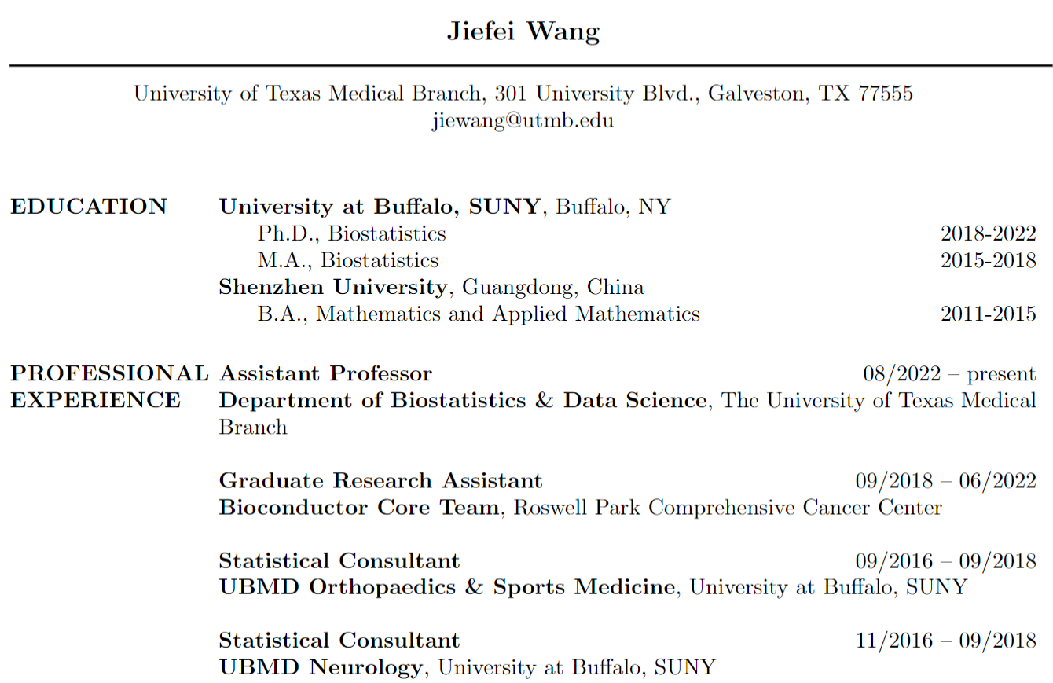

About Me

Slide 3

Workshop Organization
This is a practice-driven workshop
You are expected to do some coding
We will focus on the core concept of parallel computing

Slide 4
Before You Start
You can find the workshop container at
https://workshop.bioconductor.org/
2. The code and slides can be found at
https://github.com/Jiefei-Wang/Bioc2023-parallel-computing
Photo taken on July 10, 2018 at Buffalo

Slide 5
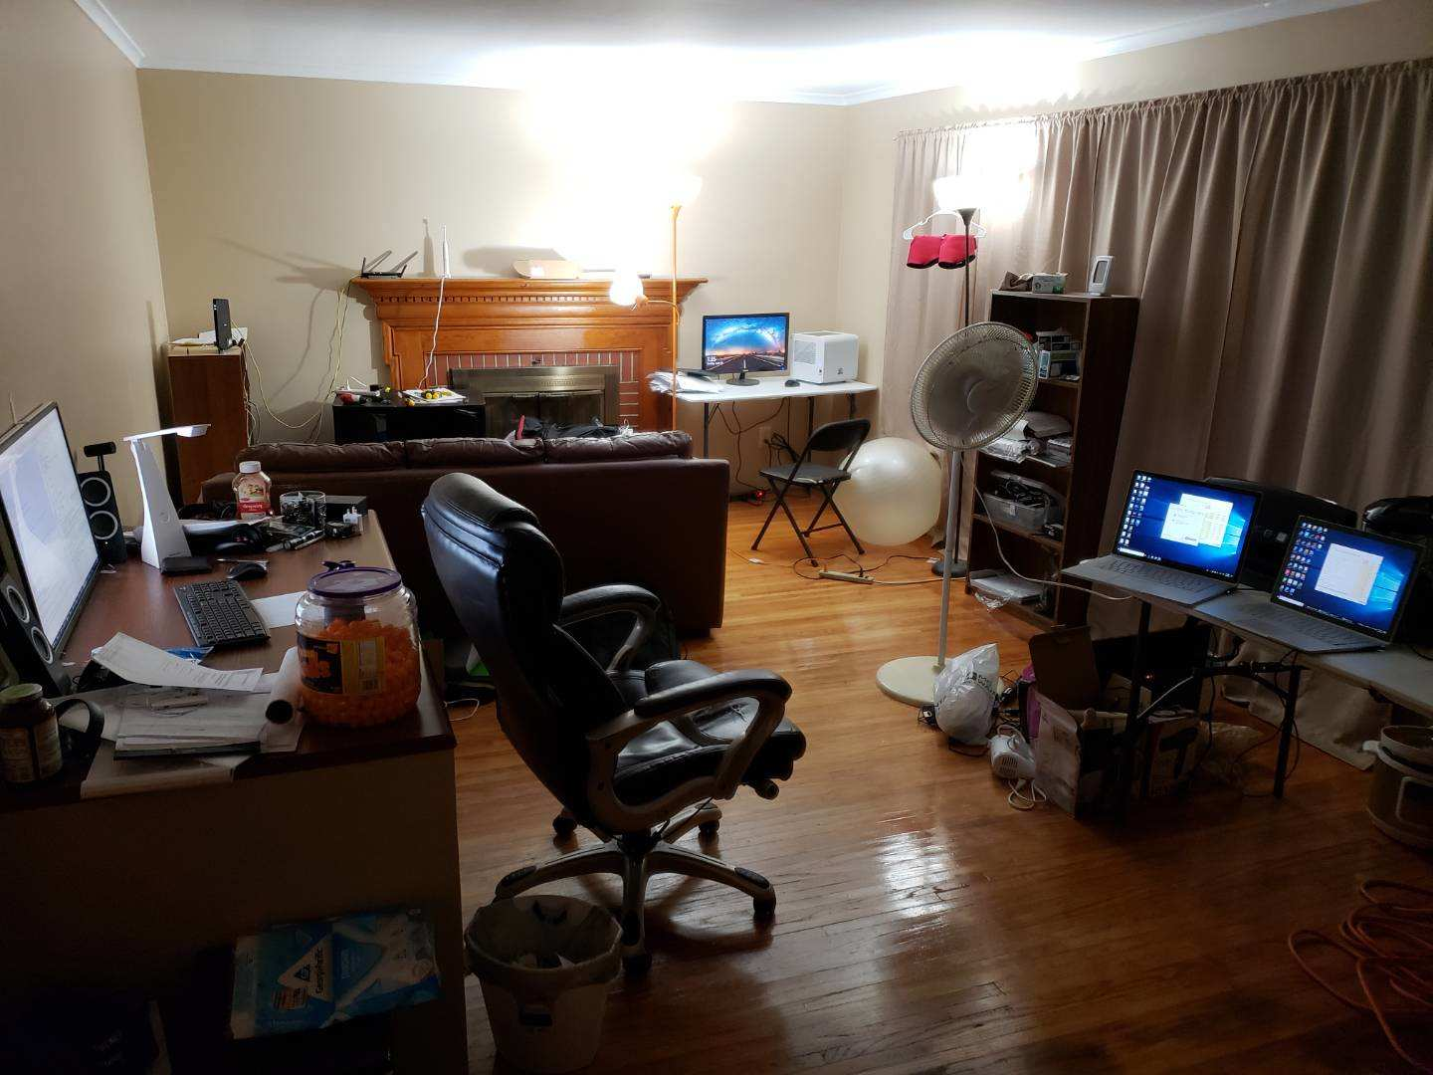
Start of the Story
A mini cluster with two desktop and two laptops
The cluster had 16 cores and 32 workers in total
The process of starting workers were incredibly cumbersome at that time
"Okay," I said, "let me make high-performance computing simpler."
Photo taken on July 10, 2018 at Buffalo

Slide 6
My Journey in Parallel Computing
BiocParallel: Bioconductor facilities for parallel computing
gpumagic: Running R code on gpu
SharedObject: Sharing data across multiple R workers
DockerParallel: Using the docker container to create R workers on cloud platform
RedisParam: Redis-based parallel computing cluster
Photo taken on July 10, 2018 at Buffalo

Slide 7
Outline
Introduction
SnowParam
MulticoreParam
RedisParam
Special Topics
Simulation
Could Computing
Photo taken on July 10, 2018 at Buffalo

Slide 8
Introduction

Slide 9
What is Parallel Computing?
How many steps does it take to put a giraffe into the refrigerator?
Open the door
Put the giraffe in the refrigerator
Close the door
How many steps does it take to put an elephant into the refrigerator?
Open the door
Take the giraffe out
Put the elephant in the refrigerator
Close the door
Photo taken on July 10, 2018 at Buffalo

Slide 10
What is Parallel Computing?
How many steps does it take to do parallel computing?
Start a master process
Start worker processes
Split a job into smaller tasks
Send tasks to workers
Receive and combine results from workers
Photo taken on July 10, 2018 at Buffalo

Slide 11
Jargon
Cluster: A set of workers working together to perform computational tasks in parallel
Master: The main R process that starts the parallel computing
AKA: Server
Worker: The R process that performs the actual computation in a cluster
AKA: Slave
Job: The code you want to compute
E.g. A call to lapply function
Task: A piece of Job

Slide 12
Cluster Structure
R worker
R worker
R master
R worker
R worker
A simple parallel computing structure
Photo taken on July 10, 2018 at Buffalo

Slide 13
Job Splitting Diagram
R worker
Job
Task 1
Task 2
Task 3
R worker
Split
Task 4
Feed
Task 5
Task 6
R worker
Task 7
Task 8
R worker
A simple job splitting Diagram
Photo taken on July 10, 2018 at Buffalo

Slide 14
SnowParam

Slide 15
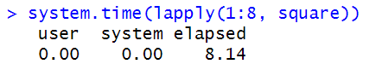
Beginner Example: SnowParam
Let's say we have a long-running function
The code below runs the square function 8 times
With no surprise, this will take about 8 seconds to finish
square <- function(x){
Sys.sleep(1)
return(x^2)
}
lapply(1:8, square)

Slide 16
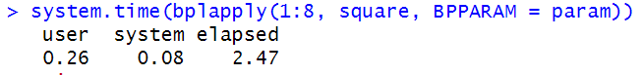
Beginner Example: SnowParam
Let"s go parallel, we first create a computing cluster with 4 workers
The code below runs the same function 8 times on 4 workers
Total time consumption
library(BiocParallel)
param <- SnowParam(worker = 4)
bpstart(param)
(optional)
bplapply(1:8, square, BPPARAM = param)
bpstop(param)

Slide 17
Parallel Computing Piece by Piece
Start a master process
Start worker processes
Split a job into smaller tasks
Send tasks to workers
Receive and combine results from workers
library(BiocParallel)
param <- SnowParam(worker = 4)
bpstart(param)
bplapply(1:8, square, BPPARAM = param)

Slide 18

SnowParam Explanation
Single Computer
R worker
R worker
R master
Local Network
R worker
R worker
library(BiocParallel)
param <- SnowParam(worker = 4)
bpstart(param)

Slide 19
Job Splitting
R worker
Job
lapply(1:8, square)
Task 1
lapply(1:2, square)
Task 2
lapply(3:4, square)
R worker
Split
Feed
Task 3
lapply(5:6, square)
R worker
Task 4
lapply(7:8, square)
R worker
bplapply(1:8, square, BPPARAM = param)

Slide 20

You have completed the basic workshop!

Slide 21
MulticoreParam

Slide 22
MulticoreParam: Why
When your computation involves an R object, each worker requires a copy of that object to perform the computation.
Single Computer - SnowParam
R worker
Copy of
object A
R worker
Copy of
object A
R master
Local Network
R worker
Copy of
object A
Object A
R worker
Copy of
object A

Slide 23
MulticoreParam: What
MulticoreParam allows the master and workers to share the same data without duplicating the object
Single Computer – MulticoreParam
R worker
R worker
R master
Local Network
R worker
Object A
R worker

Slide 24
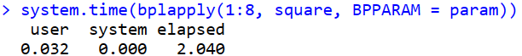
MulticoreParam: How
Creating MulticoreParam is as easy as creating SnowParam
Run the square function 8 times on 4 workers
Total time consumption
library(BiocParallel)
param <- MulticoreParam(worker = 4)
bpstart(param)
Everything before this point will be shared with the workers
bplapply(1:8, square, BPPARAM = param)
bpstop(param)

Slide 25
RedisParam

Slide 26

RedisParam: Why
SnowParam and MulticoreParam are sufficient for doing parallel computing with a single computer
However, our needs are usually not that simple

Slide 27
RedisParam: What
RedisParam allows you to connect with multiple remote workers through network
Computer 1
Computer 2
Computer 3
R worker
R worker
R master
Redis Server
Computer 4
R worker
R worker
Redis can be downloaded at https://redis.io/ or using the docker image(recommended)

Slide 28
RedisParam: How
We need to start a Redis server from a terminal
We will create master and workers in the same computer
Run the square function 8 times on 4 workers
redis-server --daemonize yes --requirepass bioc2023
library(RedisParam)
param <- RedisParam(worker = 4, redis.password = "bioc2023")
bpstart(param)
bplapply(1:8, square, BPPARAM = param)
bpstop(param)

Slide 29
Cluster Structure
Single Computer - RedisParam
R worker
R worker
R master
Redis Server
R worker
R worker

Slide 30
RedisParam: Distributed Computing
We have set up a Redis server for you to explore
We ask you to "donate" your computer for doing this parallel computing experiment
## Redis server IP and port
host <- "20.124.172.81"
port <- 888
jobname <- "demo"
## Define how many workers you want to "donate"
param <- RedisParam(
workers = 2,
redis.hostname = host,
redis.port = port,
redis.password = "bioc2023",
jobname = jobname,
is.worker = TRUE
)
bpstart(param)

Slide 31
RedisParam: Example
I will define a master-only param by
## Redis server IP and port
host <- "20.124.172.81"
port <- 888
jobname <- "demo"
## This is a master param
param <- RedisParam(
redis.hostname = host,
redis.port = port,
redis.password = "bioc2023",
jobname = jobname,
is.worker = FALSE
)
bpstart(param)
We can find the number of workers in the cluster by
bpnworkers(param)

Slide 32
RedisParam: What happened
Jiefei"s laptop
Cloud server
Donator 1
R worker
R worker
R master
Redis Server
Donator 2
R worker
R worker

Slide 33
RedisParam: Explore RedisParam
You can define the master-only cluster through
## Redis server IP and port
host <- "20.124.172.81"
port <- 888
## Random jobname
jobname <- ipcid()
message("My job queue: ", jobname)
## Master-only cluster
param <- RedisParam(
redis.hostname = host,
redis.port = port,
redis.password = "bioc2023",
jobname = jobname,
is.worker = FALSE
)
bpstart(param)
bpnworkers(param)

Slide 34
RedisParam: Explore RedisParam
The workers can be made from a separate process using the same job name
library(RedisParam)
## Redis server IP and port
host <- "20.124.172.81"
port <- 888
jobname <- "Your job queue name"
## Worker definition
param <- RedisParam(
workers = 8,
redis.hostname = host,
redis.port = port,
redis.password = "bioc2023",
jobname = jobname,
is.worker = TRUE
)
bpstart(param)

Slide 35
Mind Map
Start
Number of computers in cluster
Single computer
Multiple computer
OS type
Windows
Linux
SnowParam
MulticoreParam
RedisParam

Slide 36
Special Topics

Slide 37
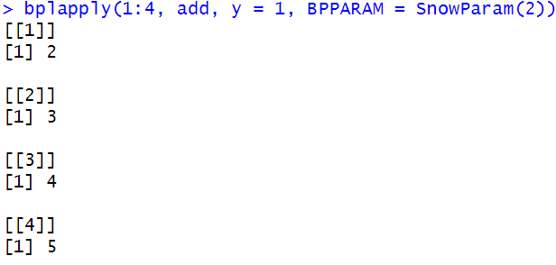
Special topic: Additional argument
Let"s say we have another "long-running" function
The second argument can be passed after specifying the add function in bplappy
If you want to change both arguments at the same time in the apply function
add <- function(x, y){
x + y
}
bplapply(1:4, add, y = 1, BPPARAM = SnowParam(2))
bpmapply(add, x = 1:4, y = 5:8, BPPARAM = SnowParam(2))

Slide 38
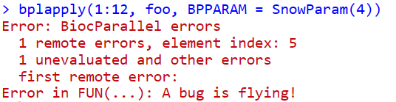
Special topic: Error Handling
Debugging parallel code is not easy
foo <- function(x){
if (x==5)
stop("A bug is flying!")
}
bplapply(1:12, foo, BPPARAM = SnowParam(4))

Slide 39
Special topic: Error Handling
A few methods can help us to locate the issue
Reduce the number of workers
Reduce the loop number
Use SerialParam and break point
bplapply(1:12, foo, BPPARAM = SnowParam(1))
bplapply(1:5, foo, BPPARAM = SnowParam(1))
foo <- function(x){
browser()
if (x==5)
stop("A bug is flying!")
}
bplapply(1:5, foo, BPPARAM = SerialParam())

Slide 40
Special topic: Loading Balance
By default, the number of tasks is equal to the number of workers
If all tasks take roughly the same time to complete, this is the optimal splitting method
Not ideal for having unbalanced loading or dynamic number of workers
We can manually overwrite it by
This will force BiocParallel to divide a job into 100 tasks (if possible)
Param <- SnowParam(4, tasks = 100)

Slide 41
Special topic: Progressbar
Sometimes we need a progress bar for impatient individuals
Note: The progressbar can only be updated when a task has been completed
Param <- SnowParam(4, tasks = 100, progressbar = TRUE)

Slide 42
Special topic: Reproducibility
When the parallel code involves randomization, a random seed can be set to promise reproducibility
Note:
The RNG seed will be set when starting the cluster
If you do not manually call "bpstart", the parallel code will return the same result each time it is called
Param <- SnowParam(4, RNGseed = 123)

Slide 43
Simulation

Slide 44
Simulation
Suppose we want to simulate the distribution of t-test statistic
## Sample size for each group
n <- 10000
## Simulate from the uniform distribution
x <- runif(n)
y <- runif(n)
## Calculate t statistic
t.test(x,y)$statistic
We wrap the code in a function so we can call it in an apply function
mySim <- function(i, n){
x <- rnorm(n)
y <- rnorm(n)
t.test(x,y)$statistic
}

Slide 45
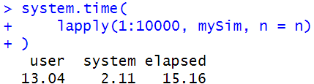
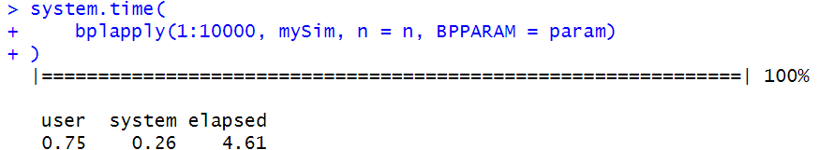
Simulation
Let"s try the vanilla apply function
n <- 10000
system.time(
lapply(1:10000, mySim, n = n)
)
We can use SnowParam to do the parallel computing
library(BiocParallel)
param <- SnowParam(worker = 8, tasks = 100, progressbar = TRUE)
bpstart(param)
bplapply(1:10000, mySim, n = n, BPPARAM = param)
bpstop(param)

Slide 46
Cloud computing

Slide 47
Cloud computing
To do cloud computing:
Start a Redis server on the cloud
Start workers on cloud
Start master locally
Image: dockerparallel/redis-r-server
Environment:
serverPort: 888
serverPassword: bioc2023
Image: dockerparallel/bioc-biocparallel-redisparam-worker
Environment:
serverIp:
serverPort: 888
serverPassword: bioc2023
queueName: myqueue
workerNum:

Slide 48
Thank you!

Slide 49
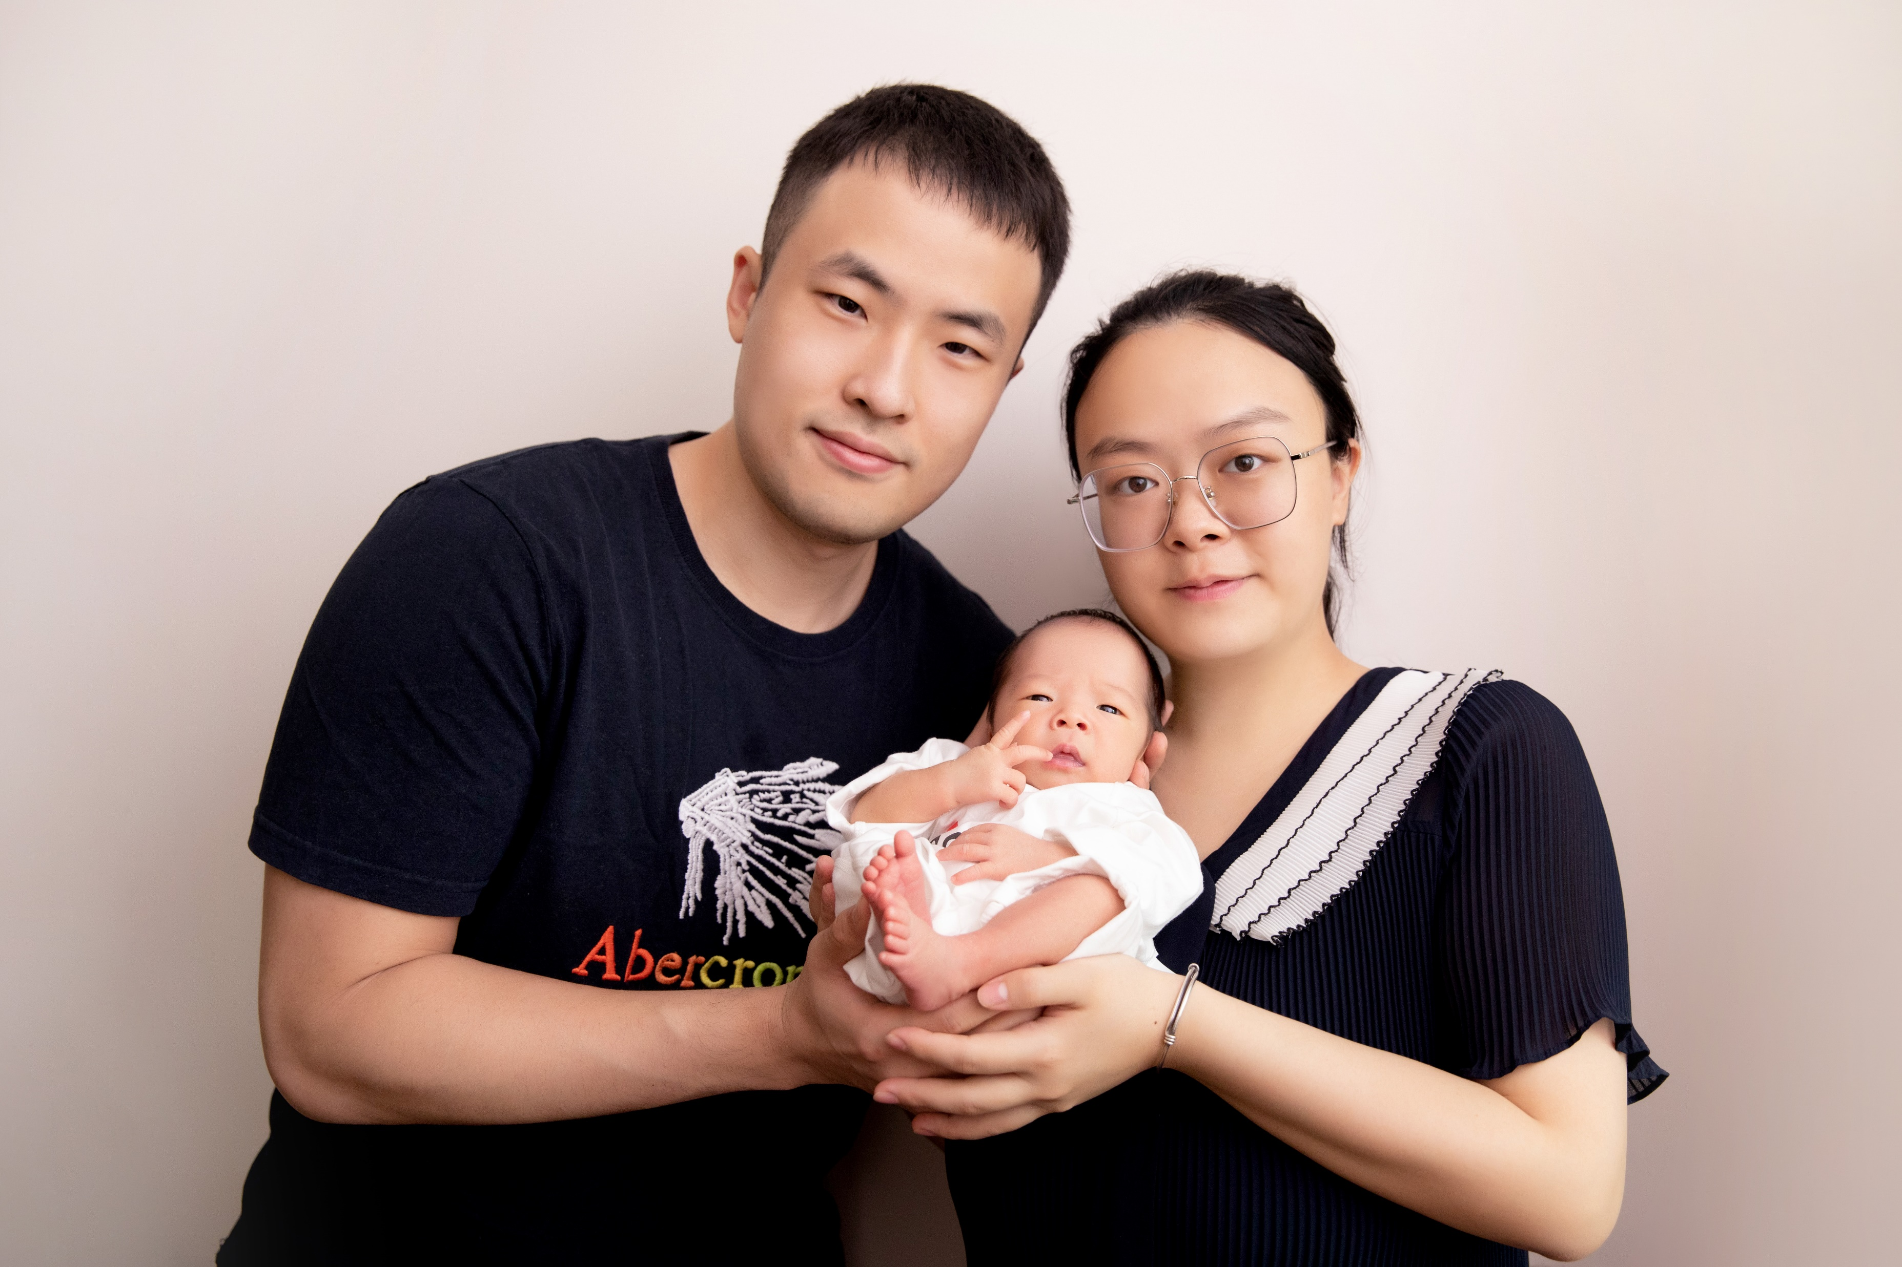
Acknowledge
Thanks for the support from
Office of Biostatistics,
University of Texas Medical Branch at Galveston
Bioconductor Core Team
Special thanks to
Martin Morgan
My family

